Slide 1


Tools For PHP

Slide 2
PHP Class 01
PHP is a server scripting language, and a powerful tool for making dynamic and interactive Web pages.
PHP is a widely-used, free, and efficient alternative to competitors such as Microsoft's ASP.
PHP 7 is the latest stable release. This tutorial uses PHP 7.2.10
<?php
echo “Hello PHP 7”;
?>

Slide 3
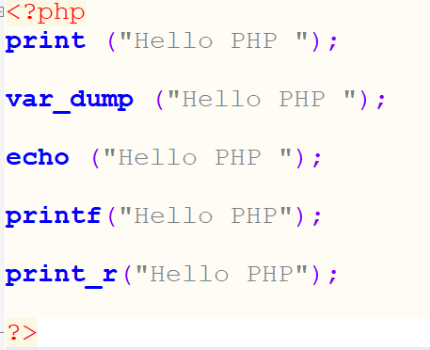
Class 02: PHP Output

Slide 4
Class 03: PHP Variable
$

Slide 5
Class 04: PHP Case Sensitivity

Slide 6
Class 05: PHP Concatenation

Slide 7
Class 06: PHP Data Types
String
Integer
Float (floating point numbers - also called double)
Boolean
Array
Object
NULL
Resource

Slide 8
PHP String
A string is a sequence of characters, like "Hello world!".
A string can be any text inside quotes. You can use single or double quotes.
Rules for integers:
An integer must have at least one digit
An integer must not have a decimal point
An integer can be either positive or negative
Integers can be specified in three formats: decimal (10-based), hexadecimal (16-based - prefixed with 0x) or octal (8-based - prefixed with 0)

Slide 9
PHP Float
A float (floating point number) is a number with a decimal point or a number in exponential form.
The PHP var_dump() function returns the data type and value.
PHP Boolean:
A Boolean represents two possible states: TRUE or FALSE.
PHP Array :
An array stores multiple values in one single variable.
The PHP var_dump() function returns the data type and value:.

Slide 10
PHP NULL Value
Null is a special data type which can have only one value: NULL.
A variable of data type NULL is a variable that has no value assigned to it.
PHP Object
An object is a data type which stores data and information on how to process that data
PHP Resource
The special resource type is not an actual data type. It is the storing of a reference to functions and resources external to PHP.
A common example of using the resource data type is a database call.

Slide 11
Class 07: PHP String Manipulation
addcslashes()
Backslashes in front of the specified characters

